Slide 1

Module 2
Renato: título de sección
2.4. Minute
Renato: título de primer apartado de esta sección.
2.4.1. What is a minute?
Read the following information, which you have to take into account to use it in the project and finally see the example.
Renato: contenido de primer apartado de esta sección.
MINUTES
Assign taking minutes to someone other than the boss. The person in charge of the minute should write down the most important decisions made during the meeting. It’s a good idea to record everything is said and done in order to avoid any misunderstandings and it is best to alternate responsibility for taking the minutes.
Throughout the meeting, it is necessary that all viewpoints raised are noted so that a summary of the entire meeting is important to be recorded and they must show what was discussed, particularly what was agreed (or dropped) and any action items: a note of something that should be done, by whom and usually with a deadline. The minutes must contain fixed information and follow a uniform structure. The headings of the document must contain the same information of the agenda, where have to be indicated the following:
Renato: dar formato distinto de fuente al texto del recuadro, pues es una lectura del tema, sugerida por las maestras.
Jonathan: Integrar imagen de acuerdo al texto.

Slide 2
Module 2
1. The name of the meeting.
2. Place, date and time.
3. Who attended the meeting.
4. Who sent apologies (this one sometimes appears as heading 1).
The minutes of the last meeting and issues arising are then used as headings with important information recorded. All topics listed in the agenda then follow, before the minutes conclude with any other business and close with the date of next meeting.
Close the meeting. Near the end of the meeting review all the decisions and tasks. Paraphrase each decision to help people focus on what they decided and to ensure the record is complete and accurate. Right in this moment is time to address issues and clear up misunderstandings. Set a date when all meeting attendees can expect to receive copies of the minutes. At the end, thank everyone for attending and close the meeting on a positive note.
(Adapted from Alred G. et al., 2009, p. 325)
Renato: éste es la continuación del texto del recuadro anterior.
Jonathan: Integrar imagen de acuerdo al texto.

Slide 3
Renato: título del segundo apartado de esta sección.
2.4.2. Example of a minute
MINUTES OF THE LANGUAGE CENTER
Minutes of the Language Center meeting held on Friday 8th July 2022, 12:00–2 p.m.
Present at meeting
Ann Brown, Jane Smith, Susy O’hara, Claire Johnson, Harry Wood, Charles Williams, Tom Lee, Dave Jones (committee members) and 32 members of the Center.
Mary Sanders, and John Davis. The secretary and the manager (administrator were also at the meeting)
Apologies for absence
Sally Smith, Tony Anderson
Minutes of the last meeting
All of the attendees agreed to the reading of the last meeting.
Report of the different languages academies
The different academies reported their work they did during the last semester from February to June.
Information about the Training Course for the intercourse period
This course will be held in August before the class start.
Arrangements for the use of the hybrid classrooms
The technician will explain about the necessary technical requirements for this type of classrooms work appropriately.
Information about the French Event organized by John Davis
There will be a cultural event to promote this course and the language Center around the member of the university and the city.
Any other Business
Date of next meeting
The next meeting is on Monday 15th August 2022, in the Language Center, classroom 1.
Look at the following example of a minute.
Renato: contenido del segundo apartado de esta sección.
Aurelio: elaborar una imagen a modo de ejemplo de una minuta, con este texto.

Slide 4
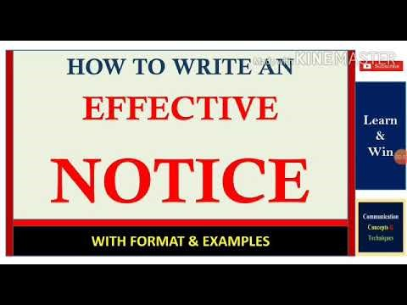
Module 2
Renato: título de sección
2.5. Notice
Renato: título de primer apartado de esta sección.
2.5.1. What is a notice?
Renato: título de primer apartado de esta sección.
How to write an effective notice: with format and example (Concepts of communication, 2020). This video shows the correct way to write a notice and gives us an example.
https://www.youtube.com/watch?v=93QvVA7Rt10

Slide 5


Module 2
Renato: título de sección.
2.6. Reports
2.6.1. What’s a report?
Renato: éste el título del primer apartado de esta sección.
Click the button on the right to see the content of the following presentation, where you can find what a report is, its elements/ components and its structure.
Renato: éste es el contenido del primer apartado de esta sección.
Aurelio: Realizar una presentación en Genially con la información de este tema. Te la comparto en documento anexo.

Slide 6

Module 2
Renato: título del segundo apartado de esta sección.
2.6.2. ¿Cómo escribir un reporte comercial? How a business report is written?
Renato: contenido del segundo apartado de esta sección.
Watch the following video where you can find some guidelines for writing a business report.
https://www.youtube.com/watch?v=Sq2SDdz1i8U

Slide 7

Renato: título del segundo apartado de esta sección.
2.6.3. Example of a report
Renato: contenido del segundo apartado de esta sección.
Look at the following example of a report.
Aurelio: elaborar imagen guiada como ejemplo de un reporte, con el texto redactado por las maestras.

Slide 8

Renato: título del segundo apartado de esta sección.
2.6.4. Useful checklist for writing a report
This is a checklist for ensuring that a report fulfills its goals:
Renato: contenido del segundo apartado de esta sección.
Aurelio: elaborar una infografía con la información proporcionada por las maestras; te la comparto en documento anexo.

Slide 9

Module 2
Renato: título del tercer apartado de esta sección.
2.6.5. Activity: report
Renato: contenido del tercer apartado de esta sección.
In this exercise you must complete the text of a report with the apropriate words.
Aurelio: elaborar un quiz de completar texto con palabras enlistadas en un recuadro; pude hacerse en genially o en educaplay. En documento anexo te comparto el texto redactado por las maestras para este ejercicio.

Slide 10
Module 2
Renato: esta información se presenta con herramienta: pestañas
Renato: título de sección.
2.7. Electronic mails
2.7.1. What’s an electronic mail?/
Renato: éste el título del primer apartado de esta sección.
Click the button on the right to see the following presentation, where you can find information about what an electronic mail is and how it is structured.
Renato: éste es el contenido del primer apartado de esta sección.
Electronic mails (e-mails)
Nowadayas writing e-mails is so common that almost nobody have problems to write messages. But what is an E-mail or email? E-mail is a short form for electronic mail. According to the Collins dictionary “Email is a system of sending written messages electronically from one computer to another”. In the workplace E-mail (or email) “functions as a medium to exchange information and share electronic files with colleagues, clients, and customers. Although e-mail may take the form of informal notes, you should follow the writing strategy and style described in correspondence because e-mail messages often function as business letters to those outside organizations and memos to those within organizations. Of course, memos and letters can also be attached to e-mails”. (J.Alread, Gerald;T. Brusaw, Charles;E, Oliu, Walter (2009).
When writing emails is very important to be very careful with the spelling, grammar, and punctuation, it does not matter if we send them to very close friends or to our colleagues or the boss. According to J. Alread, Gerald; T. Brusaw, Charles;E, Oliu, Walter (2009), It is very important to be very careful when writing to the boss or to people outside the company or organization.
Aurelio: Realizar una presentación en Genially con esta información.

Slide 11
Module 2
Renato: continua información de la diapositiva anterior.
These authors also recommend taking into account the following tips before writing emails:
writer’s checklist-Observing Workplace Netiquette.
Review your Insitution’s policy regarding the use of e-mail.
Try to keep a high level of professionalism when your write an e-mail.
Do not send email’s with jokes or spam, office gossip, or use impolite language.
Do not send offensive messages.
Do not use an e-mail account related to a hobby (gardening lover@outlook.com it’s better to use an email account based on your last name Robinson120@outlook.com
Don’t forget to include a subject line that describes the topic of the mail and in this way the recipient will get an idea of what the message is about.
Adapt forwarded messages: revise the subject line to reflect the current content and cut irrelevant previous text, based on your purpose and context.
Use the “cc:”(copy) and “bcc:”(blind copy) address lines and consider your institutions policies’.
Include a cover message for all e-mail messages with attachments (“Attached is a copy of the report for your review. . . .”).
Send a "courtesy response" to inform you need a few days or more to respond to a request.
It’s no appropriate to write in ALL UPPERCASE LETTERS (called “shouting”) or in all lowercase letters in an email.
Avoid e-mail abbreviations (BTW for by the way,for example) used in personal e-mail,chat rooms, and instant messaging.
Do not use emoticons when you write business and professional e-mails.
Aurelio: esta información debe integrarse en la presentación solicitada en la dispositiva anterior.

Slide 12
Module 2
Renato: esta información es continuación de las dos diapositivas anteriores.
Other relevant characteristics to consider are:
- Break up your writing into short paragraphs to avoid dense of blocks of text.
- Consider giving a general specification in the main part of a short paragraph for messages that are longer. providing an overview at the top in a brief paragraph for messages that run longer than a screen of text.
- Place your reply to someone else’s message at the top of the e-mail window so that recipients can quickly see your answer.
- When you reply to a message, quote only relevant parts. If your system does not distinguish the quoted text, note it with a greater-than symbol (>).
(Adapted from Alred, G. et al. 2009, p 162-165)
Aurelio: esta información debe integrarse en la presentación solicitada en la dispositiva anterior.

Slide 13
Module 2
Renato: esta información es continuación de las tres diapositivas anteriores.
Knowing the parts of an email can be very useful in English. You might have to tell someone your email address, or try to describe where you wrote a piece of information. In any case it’s best to start this course at the beginning with the most basic structures.
Here are the different parts of an e-mail:
The address: this is the line where you enter in the email address you wish to send the mail to. You usually have three options when sending an email:
· to: this is where you type the address you wish to send your e-mail to.
· add Cc: this is to add other receivers. It stands for Carbon Copy.
· add Bcc: to add some other receivers, but in this case you don’t want the rest to know you are sending copying this person in. It stands for Blind Carbon Copy.
The subject line: this is the line that appears to let people know what you will be talking about. This is very important since it gives the main information of your e-mail.
The opening: to open your email, usually an expression of greeting.
The body of text: the main part of the email.
The closing: to finish off the email.
The signature: your name.
(Adapted from Rachel Rlanguages, 2010)
Aurelio: esta información debe integrarse en la presentación solicitada en la dispositiva anterior.

Slide 14
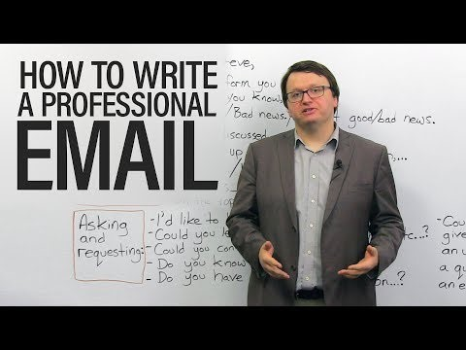
Module 2
Renato: título del segundo apartado de esta sección.
2.7.2. How to write an electronic mail ?
Watch the following video about the most common expressions used when writing emails. You can also observe what you must or mustn't you do when writing an email.
Renato: contenido del segundo apartado de esta sección.
https://www.youtube.com/watch?v=3Tu1jN65slw

Slide 15
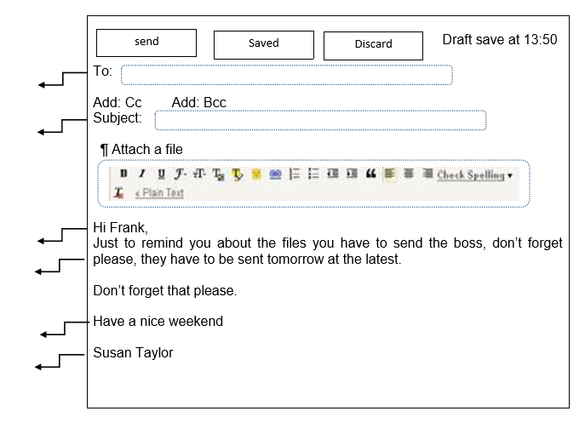
Module 2
Renato: título del tercer apartado de esta sección.
2.7.3. Labelling the e-mail
Renato: contenido del tercer apartado de esta sección.
Activity
Look at the example of an e-mail, label it with the words you read in the previous reading and the information you listen to in the video.
Aurelio: elaborar un ejercicio quiz de completar con la información de esta imagen. En la siguiente diapositiva está el ejercicio resuelto.

Slide 16
Module 2
Answers
The address
Subject line
The opening
The body of the text
The closing
The signature

